Slide 1
MICROPROCESSOR, MICROCONTROLLER AND INTERFACING

Slide 2
INTRODUCTION
Microprocessor
It is a computer processor that incorporates
all the functions of CPU (Central Processing Unit) on a single IC (Integrated Circuit) or at the most a few ICs

Slide 3
Introduction (Contd..)
Microprocessors are not designed for multiple tasks but they are used where tasks are tricky and complex such as games running, improvement of software, and other programs that need high capacity for memory and where input and output are mixed.
It may be introduced as the heart of a computer circuit.

Slide 4
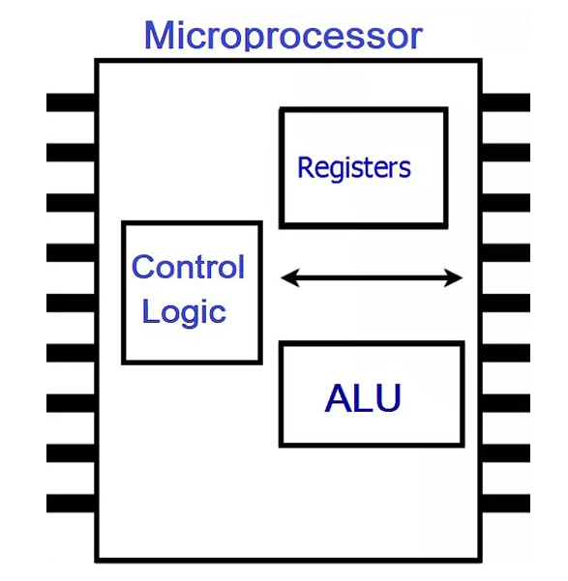

Slide 5
Introduction(Contd..)
The main operation center of a microprocessor contains registers, ALU, and a control unit.
Microprocessors are categorized based on the data size in which ALU applies.
If the ALU section of the microprocessor is performing on 8-bit data in one simple cycle, it will be introduced as an 8-bit microprocessor.
Likewise, if the ALU is working on 16-bit data, then it is a 16-bit system.

Slide 6
Introduction (Contd..)
Fundamentally, the operation of any instruction within the processor contains three cycles.
1. At first, the data is received.
2. It is recovered
3. It is operated based on the decoded instruction.
The data or code is sent with the bias system when the suitable monitoring signals are produced by the CU. Therefore, the ALU can run a specific operation.
As a result, we say the processor operates the particular application but the instruction data which is found by it, is stored in an additional chip or external memory.
Thus, we say that a microprocessor is a single chip moddeled for general computational applications.

Slide 7
Microprocessors Characteristics
Microprocessors are multipurpose devices that can be designed for generic or specialized functions. The microprocessors of laptops and smartphones are general purpose whereas ones designed for graphical processing or machine vision are specialized ones. There are some characteristics that are common to all microprocessors.
These are the most important defining characteristics of a microprocessor −
Clock speed
Instruction set
Word size

Slide 8
Clock Speed
Every microprocessor has an internal clock that regulates the speed at which it executes instructions and also synchronizes it with other components. The speed at which the microprocessor executes instructions is called clock speed. Clock speeds are measured in MHz or GHz where 1 MHz means 1 million cycles per second whereas 1 GHz equals to 1 billion cycles per second. Here cycle refers to single electric signal cycle.

Slide 9
Word Size
Number of bits that can be processed by a processor in a single instruction is called its word size. Word size determines the amount of RAM that can be accessed at one go and total number of pins on the microprocessor. Total number of input and output pins in turn determines the architecture of the microprocessor.

Slide 10
Instruction Set
A command given to a digital machine to perform an operation on a piece of data is called an instruction. Basic set of machine level instructions that a microprocessor is designed to execute is called its instruction set. These instructions do carry out these types of operations −
Data transfer
Arithmetic operations
Logical operations
Control flow
Input/output and machine control

Slide 11
Overview of Micro Computer Structure
As the name implies,microcomputers are small computers.
They range from small controllers that work directly with 4 bit words.
CPU is usually a single IC called a microprocessor.
Microprocessor is the CPU to which we add ROM,RAM and ports to make a microcomputer.

Slide 12
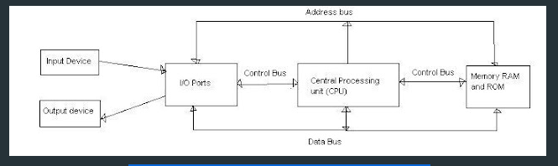
Overview of Micro Computer Structure

Slide 13
MicroComputer
The major parts of microcomputers are central processing unit (CPU), memory, and input and output unit.
To connect these parts together through three sets of parallel lines, called buses. These three buses are Address bus, data bus, and Control bus.

Slide 14
Address Bus
The address bus consists of 16, 20, 24, or more parallel signal lines, through which the CPU sends out the address of the memory location.
This memory location is used for to written to or read from. The number of memory location is depends on 2 to the power N address lines.
Example, a CPU with 16 address lines can address 2¹⁶ or 65,536 memory locations. When the CPU reads data from or writes data to a port.
The port address is also sent out on the address bus.
This is unidirectional. This means that the CPU can send data to a memory location or I/O ports.

Slide 15
Data Bus
The data bus consists of 8, 16, 32 or more parallel signal lines. The data bus lines are bidirectional.
This means that the CPU can read data from memory or from a I/O port as well as send data to a memory location or to a I/O port.
In a system, many output devices are connected to the data bus, but only one device at a time will be enabled to the output.

Slide 16
Control Bus
The control bus consists of 4-10 parallel signal lines. The CPU sends out signals on the control bus to enable the outputs of addressed memory devices or port devices.
Typically control bus signals are memory read, memory write, I/O read and I/O write.
To read a data from a memory location, the CPU sends out the address of the desired data on the address bus and then sends out a memory read signal on the control bus.
The memory read signal enables the addressed memory device to output the data onto the data bus where it is read by the CPU.

Slide 17
Microprocessor Evolution and Types
Transistor was invented in 1948 (23 December 1947 in Bell lab).
IC was invented in 1958 (Fair Child Semiconductors) By Texas Instruments J Kilby.
The first microprocessor was invented by INTEL(INTegrated ELectronics).

Slide 18
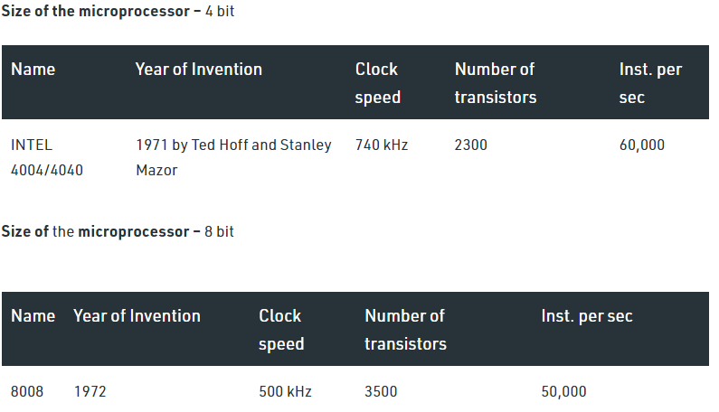
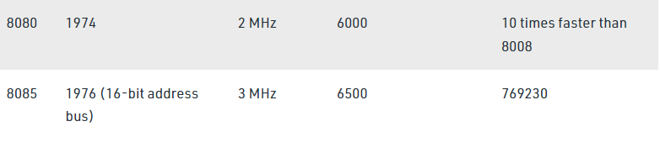
Microprocessor Evolution

Slide 19
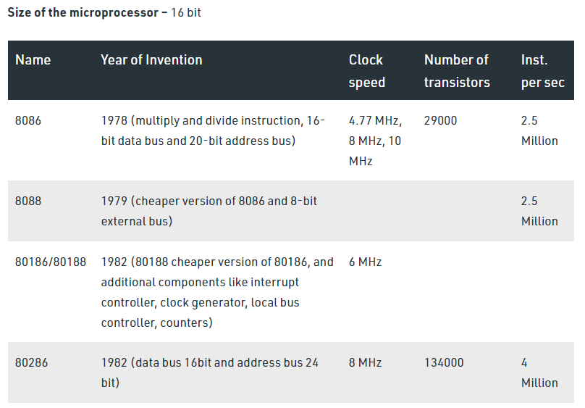

Slide 20
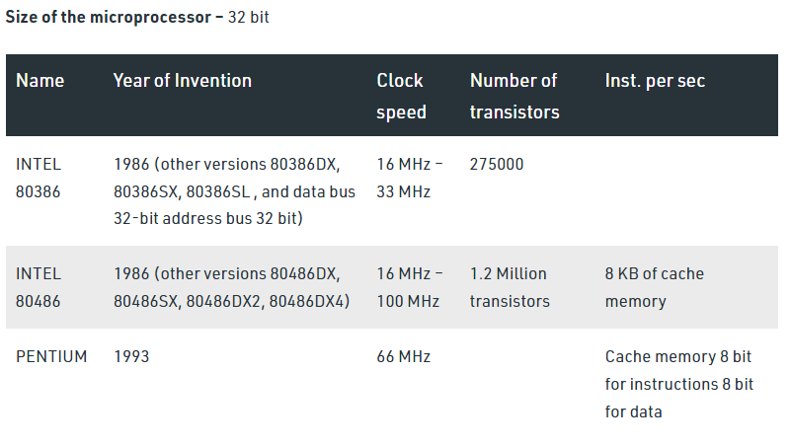

Slide 21
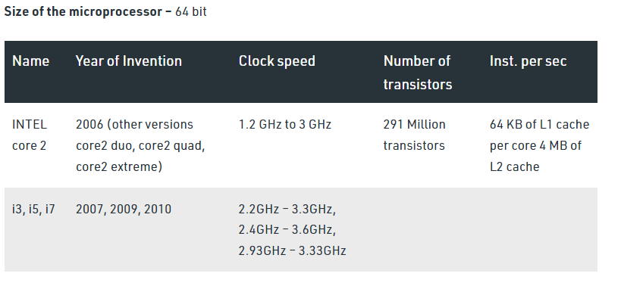

Slide 22
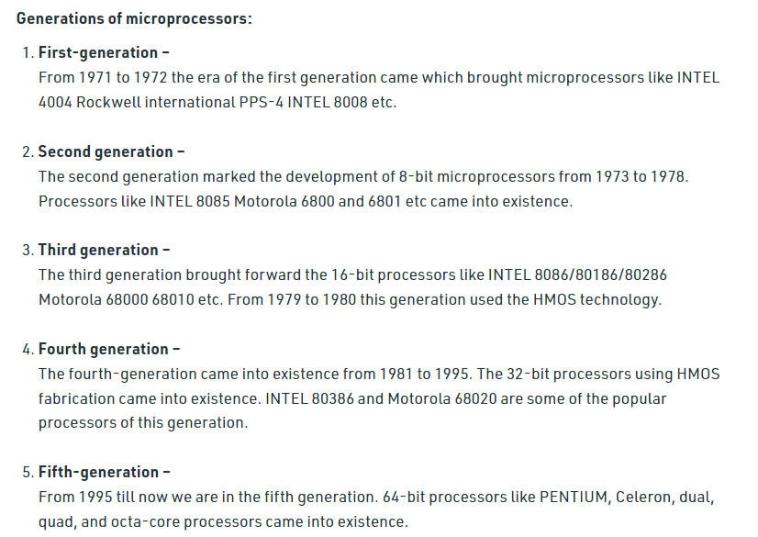

Slide 23
Microprocessor Applications
A microprocessor makes daily life easier because of its low cost, low power, small weight, and vast application in every field. There are several applications of microprocessors. Some of the important applications are:
Household Devices
The programmable thermostat allows the control of temperature at homes. In this system, a microprocessor works with the temperature sensor to determine and adjust the temperature accordingly.
High-end coffee makers, Washing machines, and radio clocks contain microprocessor technology.
Some other home items that contain microprocessors are: microwaves, toasters, televisions, VCRs, DVD players, ovens, stoves, clothes washers, stereo systems, home computers, alarm clocks, hand-held game devices, thermostats, video game systems, bread machines, dishwashers, home lighting systems and even some refrigerators with digital temperature control.

Slide 24
Transportation Industry
Automobiles, trains and planes also use microprocessor technology.
Consumer vehicles-buses, cars, trucks -integrate microprocessors to communicate important information throughout the vehicle. E.g., navigation systems provide information using microprocessors and global positioning system (GPS) technology.
Computers and Electronics
Microprocessor-drives technology is the brain of the computer. They are used in all type of computers ranging from microcomputers to supercomputers.
A cell phone or mobile device executes game instructions by way of the microprocessor.
VCRs, televisions and gaming platforms also contain microprocessors for executing complex instructions and tasks.
In Medicals
Many medical devices, like an insulin pump, are typically controlled by a microprocessor. The microprocessors perform various functions, such as processing data from bio-sensors, storing measurements, and analyzing results.

Slide 25
Instrumentation
Microprocessor is also very useful in the field of instrumentation. Function generators, frequency counters, frequency synthesizers, spectrum analyses and many other instruments are available, when microprocessors are used as controller.
Entertainment
The use of microprocessor in entertainment equipment, toys and home entertaining applications is making them more useful and full of features.
Embedded Systems at Home
A number of modern devices in the home are microprocessor based i.e. camera; washing machines; calculators; hi-fi systems; telephones; microwave ovens; burglar alarms etc. The input are usually simple numeric keyboards, sensors, buttons or while the output include lights, simple LCD screens displays, motors and relays, LEDs, buzzers etc.
Office Automation and Publication
Microprocessor based system with software packages has changed the office environment. Microprocessors based systems are being used for spread sheet operations, word processing, storage etc.
The Publication technology has revolutionized by the microprocessor.

Slide 26
Communication
In communication the telephone industry is most important. In this industry, microprocessors are used in digital telephone sets, telephone exchanges and modem etc.
The use of microprocessor in satellite communication, television, has made teleconferencing possible.
Railway reservation and airline reservation system also uses microprocessor technology. WAN (Wide Area Network) and LAN (Local Area Network) for communication of vertical information through computer network.

